Slide 1



Society360
City Management System
By: Hammad Siddique
Haziq Naeem
Muhammad Bilal

Slide 2

Introduction
Society360 is a City Management System that digitalizes lives of citizens. It provides a platform for both admins and residents to be able to live comfortably. Residents are able to register properties, book recreational facilities, apply for business licenses and even vote digitally for city initiatives. Admins, on the other hand, are able to schedule infrastructure maintenances as well as view and take action on all types of requests submitted by the residents

Slide 3


Usecases
Register Property
Reserve Recreation Facility
Submit Public Feedback
Pay Utility Bill
Request Public Service
Digital Voting
Acquire Business License
Report Crime or Traffic Incident
Schedule Infrastructure Maintenanace
Manage Institute
Manage Healthcare

Slide 4

GRASP & Design Patterns
We have implemented low-coupling and high cohesion using design patterns such as the Singleton Pattern. The system has been using development flows and all theory has been thoroughly implemented. Diagrams such as System Sequence, Package and Component as well as Domain models have been made.
01
02
03
Low Coupling
High Cohesion
Singleton Pattern
Low Coupling has been used, with less class linking thus reducing dependency between classes
Each class created fulfills its purpose entirely which results in high cohesion and no need for extra classes
design patterns such as singleton pattern has been used. This is used in the Admin class of which only one object exists

Slide 5

User Interface: This package is responsible for implementing all the user interface and the user experience in the project
01
Packages
Business Logic: This package is responsible for implementing all the business logic of the project. This includes executing queries and passing data to the database layer
02
There are four packages used: User Interface, Domain Entity, Database and Business Logic. When the user interacts with the UI layer, an object from a Domain Entity class is created which is passed into the Business Logic Layer via a function. This function runs a query that has been taken from the database layer. The database layer establishes connection to database and provides all the queries.
Domain Entity: This package contains all the classes of which the project can have an object, for example, a resident or an admin. This provides objects to the Business Logic Layer.
03
Database: This establishes connection to the MySQL database that the project uses and provides queries that are required to be run in the project
04

Slide 6

Our Most Complex Usecase
Our most complex use case is the Manage Institute use case. This use case belongs to the Admin and is made up of different parts. It basically allows the Admin to Add, Delete and View the current Institutions in the city. As always, validations are applied and Institute ID, which is the primary key, cannot be duplicated

Slide 7
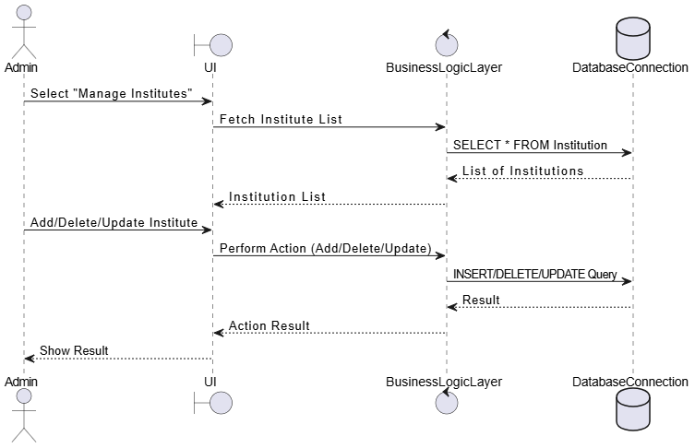
The Sequence Diagram

Slide 8


APP UI

Slide 9
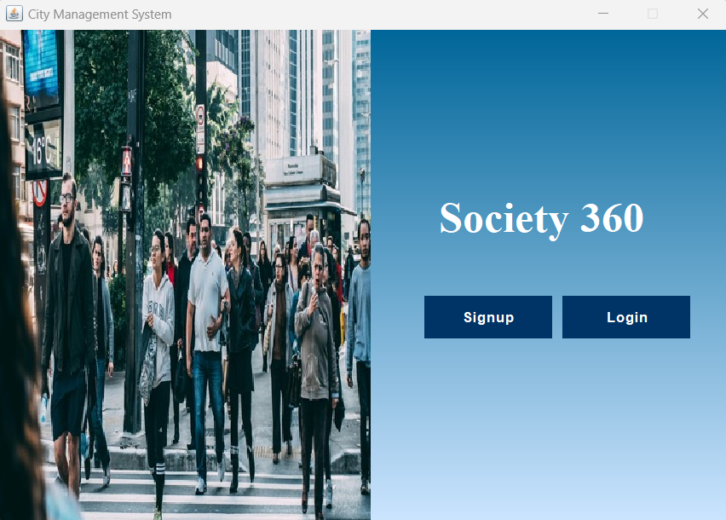
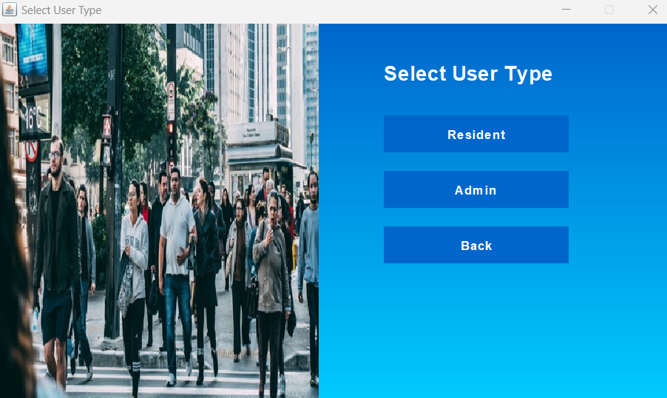

Slide 10
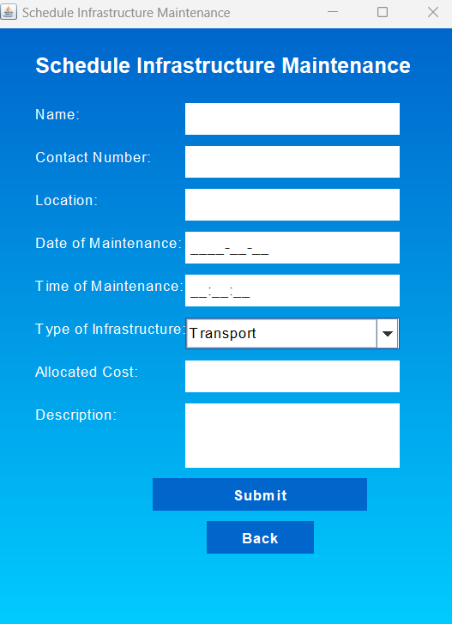
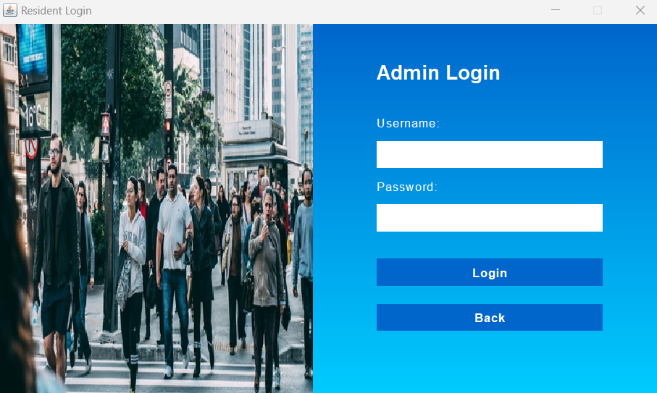

Slide 11
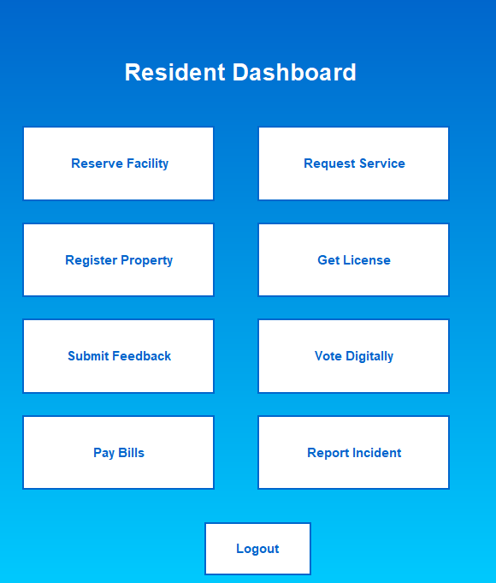
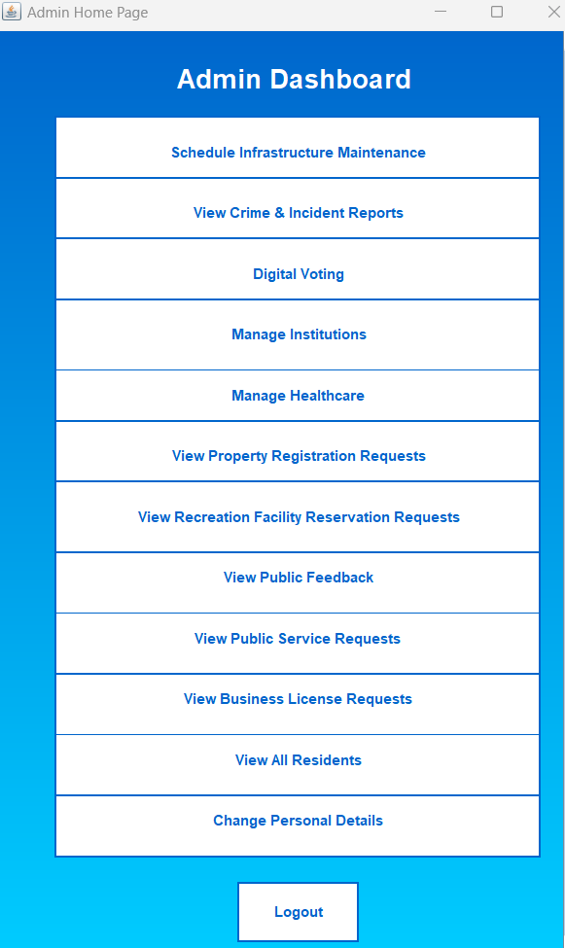
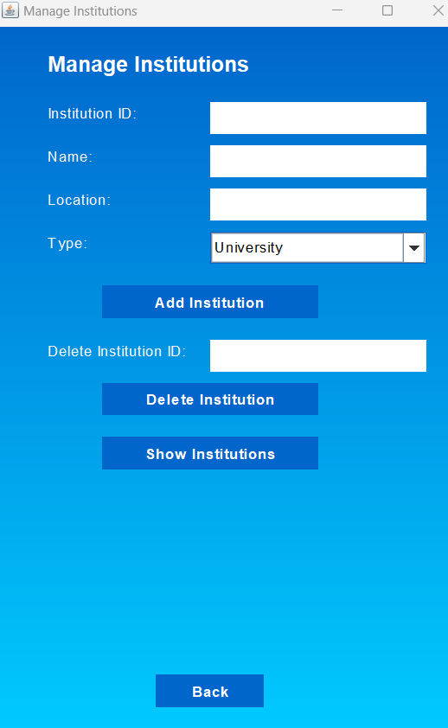

Slide 12


Soceity360
THANK YOU!

